Slide 1
Basic Setup Training
Copyright © 2010 Instek Digital Co., Ltd. All rights reserved. CONFIDENTIAL

Slide 2
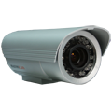
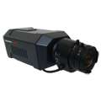
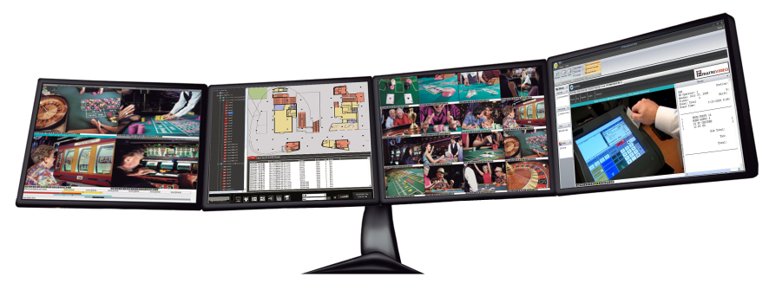
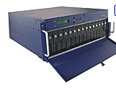
Base Installation Training
NETWORK CONNECTION OVERVIEW
Analog Cameras
IP Cameras
hDVR
Ethernet Switch
COLDSTORE
Command Center / Command Center Lite
Copyright © 2010 Instek Digital Co., Ltd. All rights reserved. CONFIDENTIAL

Slide 3
Base Installation Training
INSTALL COMMAND CENTER LITE
a. Download the latest copy of Command Center Lite from the FTP site.
b. The login credentials are as follows:
- Host Name: ftp.instekdigital.com
- Username: veracityusa@instekdigital.com
- Password: veracityid
- Folder: /Software
- Filename: CCLite 5.x.x.x
c. Double click on the executable file and follow the on-screen prompts to
complete the installation.
Copyright © 2010 Instek Digital Co., Ltd. All rights reserved. CONFIDENTIAL

Slide 4
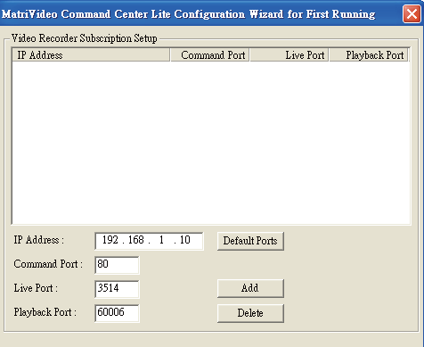
Base Installation Training
SUBSCRIBE THE RECORDER (hDVR/NVR)
a. Run the Command Center Lite software. During the first application run, you will be asked to subscribe (or add) the recorder to the video recorder subscription list, so you can view the cameras.
b. Type in the IP address, Command Port, Live Port and Playback Port of the recorder.
IP Address: 173.220.182.246
Command Port: 80
Live Port: 3514
Playback Port: 60006
Note: Do not change these port numbers if connecting the recorder in a LAN environment. Click Add to continue. You can add additional recorders in a similar fashion. When all the recorders have been added, click Next to continue.
Copyright © 2010 Instek Digital Co., Ltd. All rights reserved. CONFIDENTIAL

Slide 5
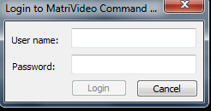
Base Installation Training
STEP 5: LOG INTO COMMAND CENTER/ COMMAND CENTER LITE
c. Finish the configuration wizard and log into Command Center Lite. The default username and password will be provided to you by your sales representative.
Copyright © 2010 Instek Digital Co., Ltd. All rights reserved. CONFIDENTIAL

Slide 6
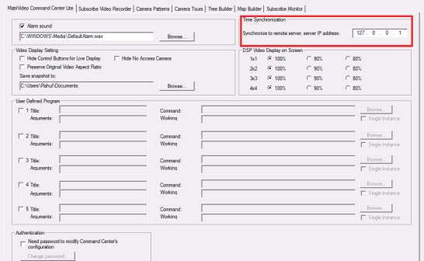
Base Installation Training
TIME SYNC WITH THE RECORDER
a. Click on the MatriVideo Command Center Lite Setup Icon on the bottom left corner of the screen.
b. Type in the IP address of the recorder: 173.220.182.246. This will keep the time in sync between the recorder(NVR) and your PC running the Command Center application.
Copyright © 2010 Instek Digital Co., Ltd. All rights reserved. CONFIDENTIAL

Slide 7
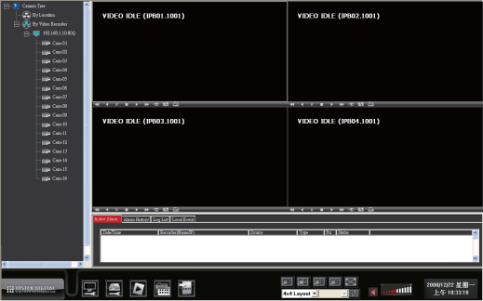
Base Installation Training
VIEW THE CAMERAS
a. Click on the “+” icon next to the IP address of the recorder to expand your camera tree.
Copyright © 2010 Instek Digital Co., Ltd. All rights reserved. CONFIDENTIAL

Slide 8
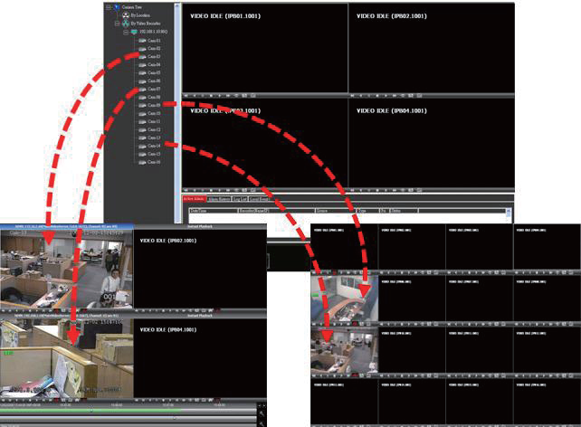
Base Installation Training
VIEW THE CAMERAS (continued…)
Drag and drop the video source from the camera tree to the “blank” patterns (1x1, 2x2, 3x3 or 4x4) window to view the cameras.
Copyright © 2010 Instek Digital Co., Ltd. All rights reserved. CONFIDENTIAL

Slide 9
Setting Up the Cameras
(OPTIONAL)
Copyright © 2010 Instek Digital Co., Ltd. All rights reserved. CONFIDENTIAL

Slide 10
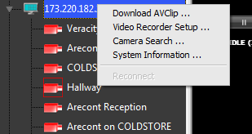
Base Installation Training
SETTING UP THE CAMERAS
a. Right-click on the recorder (labeled by its IP address) in the camera tree panel and click Video Recorder Setup. When asked to login the default username is admin and the password is id.
b. Click the Camera Setup tab.
Copyright © 2010 Instek Digital Co., Ltd. All rights reserved. CONFIDENTIAL

Slide 11
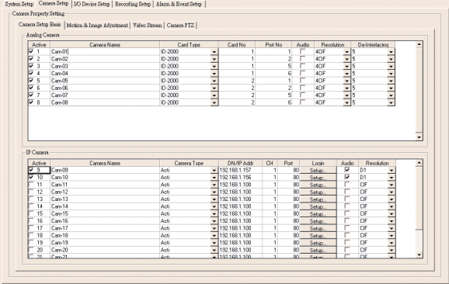
Base Installation Training
SETTING UP THE CAMERAS
a. Click Camera Setup Basic tab. Click the Active box next to the camera name(s) to enable the camera. Analog cameras can be setup on the top part of the window and the IP cameras can be setup on the bottom part of the window. You can also change the camera name by clicking on the camera name row for each camera, such as “Cam-01”, “Cam-02”.
b. For setting up IP cameras, refer to the next page.
Note: Before continuing, you must configure the IP address of each camera to ensure it is in the same network segment as the recorder. Refer to your camera’s user manual for more information on how to do this.
Copyright © 2010 Instek Digital Co., Ltd. All rights reserved. CONFIDENTIAL

Slide 12
Base Installation Training
SETTING UP IP CAMERAS
e. On the IP Camera table, type in a descriptive Camera Name.
f. Select the appropriate Camera Type.
g. Type the IP Address of the IP cameras. Domain names are supported if available on the
surveillance network.
Copyright © 2010 Instek Digital Co., Ltd. All rights reserved. CONFIDENTIAL

Slide 13
Base Installation Training
SETTING UP IP CAMERAS (Continued…)
h. The Port number is dependent on the IP camera. Ch refers to the channel number of the video server. See the IP camera or video server manual for additional information.
i. The Login option is used to access the camera configuration settings. If the camera configuration menu requires a username and password, then that information will need to be entered in this field.
j. Click Audio, if supported.
k. Select the Resolution for the camera from the drop-down list box.
l. Finally, select the Video Stream tab to set up the Frame Rate and Quality (Bitrate) for each individual camera.
NOTE: The setup for each IP camera is a little bit different, as it is dependent on the camera manufacturer. The “application notes” to assist with the camera setup can be downloaded directly from Instek Digital’s website: http://www.instekdigital.com/id/camera_list. Select the manufacturer and then navigate to the bottom of the page and download the appropriate application notes:
Copyright © 2010 Instek Digital Co., Ltd. All rights reserved. CONFIDENTIAL

